Slide 1

Video Anomaly Detection – Design Notes

Slide 2
Data_Loader
Data_Loader
Reads all videos in the data folder and builds a MultiZipVideoDataset
dataset: MultiZipVideoDataset
dataloader: torch.utils.data.DataLoader(dataset, batch_size=1, shuffle=True)
zip_file_paths = [os.path.normpath(r'C:\\Users\\karthik.venkat\\PycharmProjects\\video_anomaly_detection\\data\\Anomaly-Videos-Part-1.zip'), os.path.normpath(r'C:\\Users\\karthik.venkat\\PycharmProjects\\video_anomaly_detection\\data\\Anomaly-Videos-Part-2.zip'), os.path.normpath(r'C:\\Users\\karthik.venkat\\PycharmProjects\\video_anomaly_detection\\data\\Training-Normal-Videos-Part-1.zip') ]
Iterator and dataset.samples attribute returns vidoes as numpy arrays

Slide 3
Load_video_from_dataset
dataset = MultiZipVideoDataset(zip_file_paths=zip_file_paths, transform=None) dataloader = torch.utils.data.DataLoader(dataset, batch_size=32, shuffle=True) samples = dataset.samples

Slide 4
Parse_data_loader
For a given Data_Loader, passes each video through R3D
extracts penultimate features
Saves feature to processed folder

Slide 5
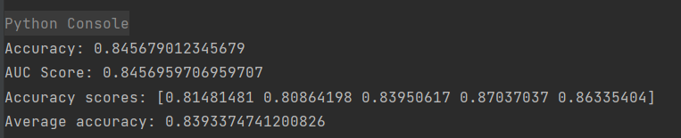
Current Results – with R3D-18 feature extraction and SVM classifier - Partial Data set

Slide 6
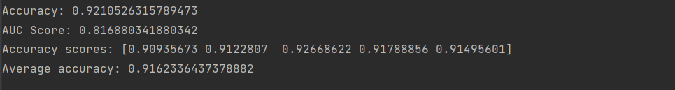
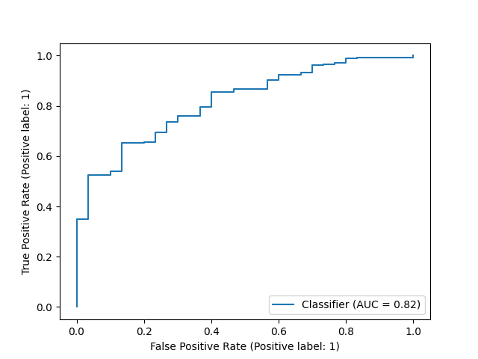
Performance: Full data set

Slide 7
Design Options to incorporate
Pre-Processing
Include full set of anomalies and normal videos as used in Sultani baseline
Use exact same videos for testing and training
Use Video Attention model to generate embeddings for anomalous segments
Learning Model Architecture
Build in Weakly Supervised Regression model instead of SVM classifier
Can a Transformer style architecture be used?
How to use attention from a transformer in the weakly supervised setting? ViT input is video slices, but trained to give video classification overall, does attention over the slices localise the anomaly? Is there a way to incorporate the pos/neg bagging process from the older method?

Slide 8
Ideas
Frames within Videos and Slices within Frames to localize the anomaly – use attention over the slices
Integrate attention into the weakly supervised learning process

Slide 9
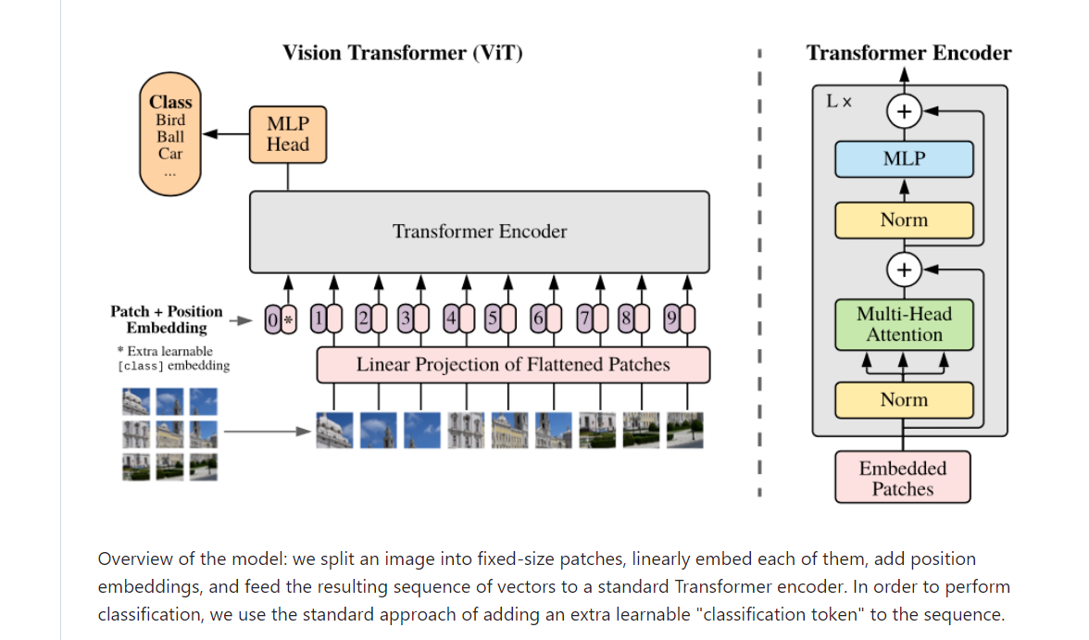

Slide 10
Transformer for Video - Notes
Video classification with transformers
addes positional embeddings to CNN feature maps
Uses the transformer for classification
https://keras.io/examples/vision/video_transformers/

Slide 11
Title of presentation
Secondary title
Name
Name
Department
Institution
Month XX, 20XX

Slide 12
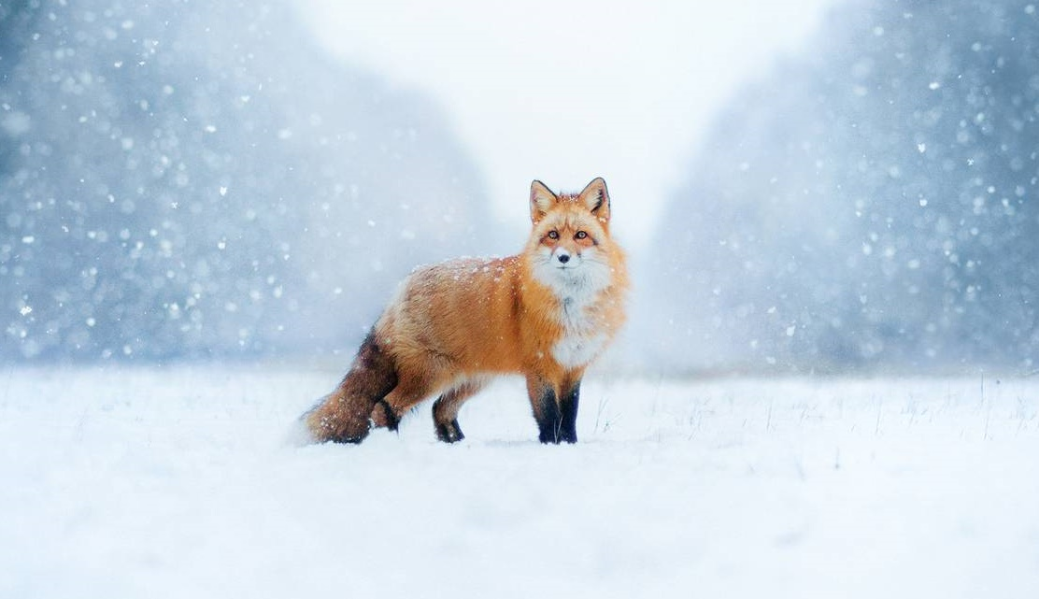
Coat-color variation in red foxes
Environmental factors that affect fur color
Hayden Cook
Quinn Campbell, Ph.D.
Department of Biology
Jasper University
December 12, 2021

Slide 13
Title of presentation
Secondary title
Name
Name
Department
Institution
Month XX, 20XX

Slide 14

Coat-color variation in red foxes
Environmental factors that affect fur color
Hayden Cook
Quinn Campbell, Ph.D.
Department of Biology
Jasper University
December 12, 2021

Slide 15
Short summary of the presentation; no longer than two lines​
Title of section 1
Title of section 2
Title of section 3

Slide 16
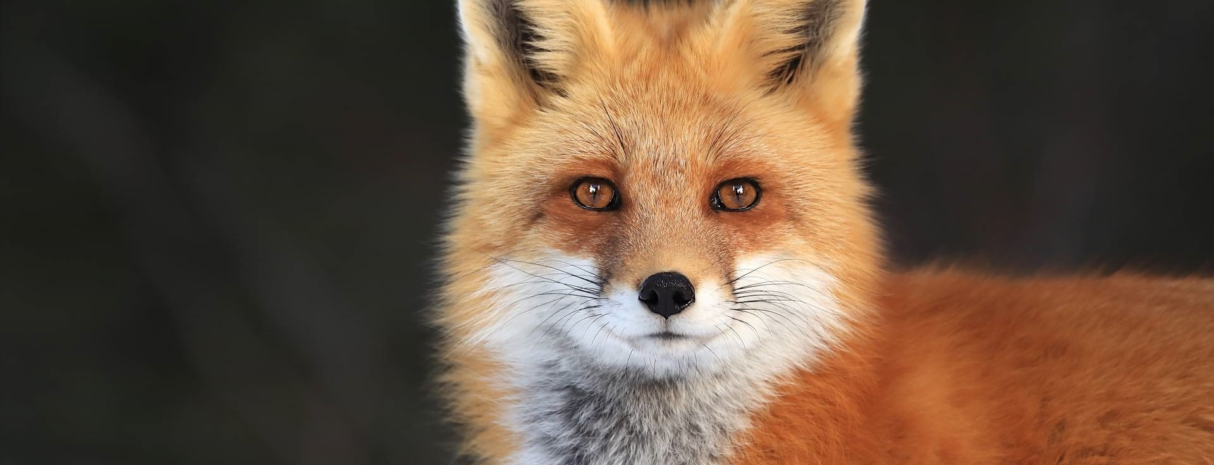
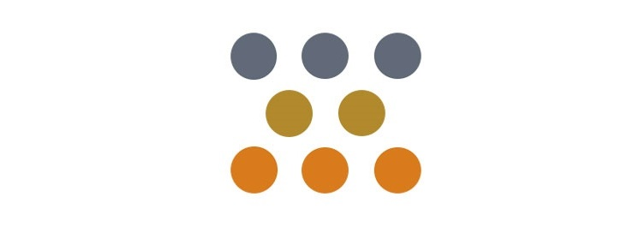

This study focused on coat-color variation in red foxes to learn if environmental factors affect coat-color outcomes
Coat-color variation in
red foxes
Population density and
coat color​
Elevation and coat
color​

Slide 17
One-sentence headline stating the main takeaway message for the slide; no longer than two lines
Info or call-out
Info or call-out
Info or call-out

Slide 18
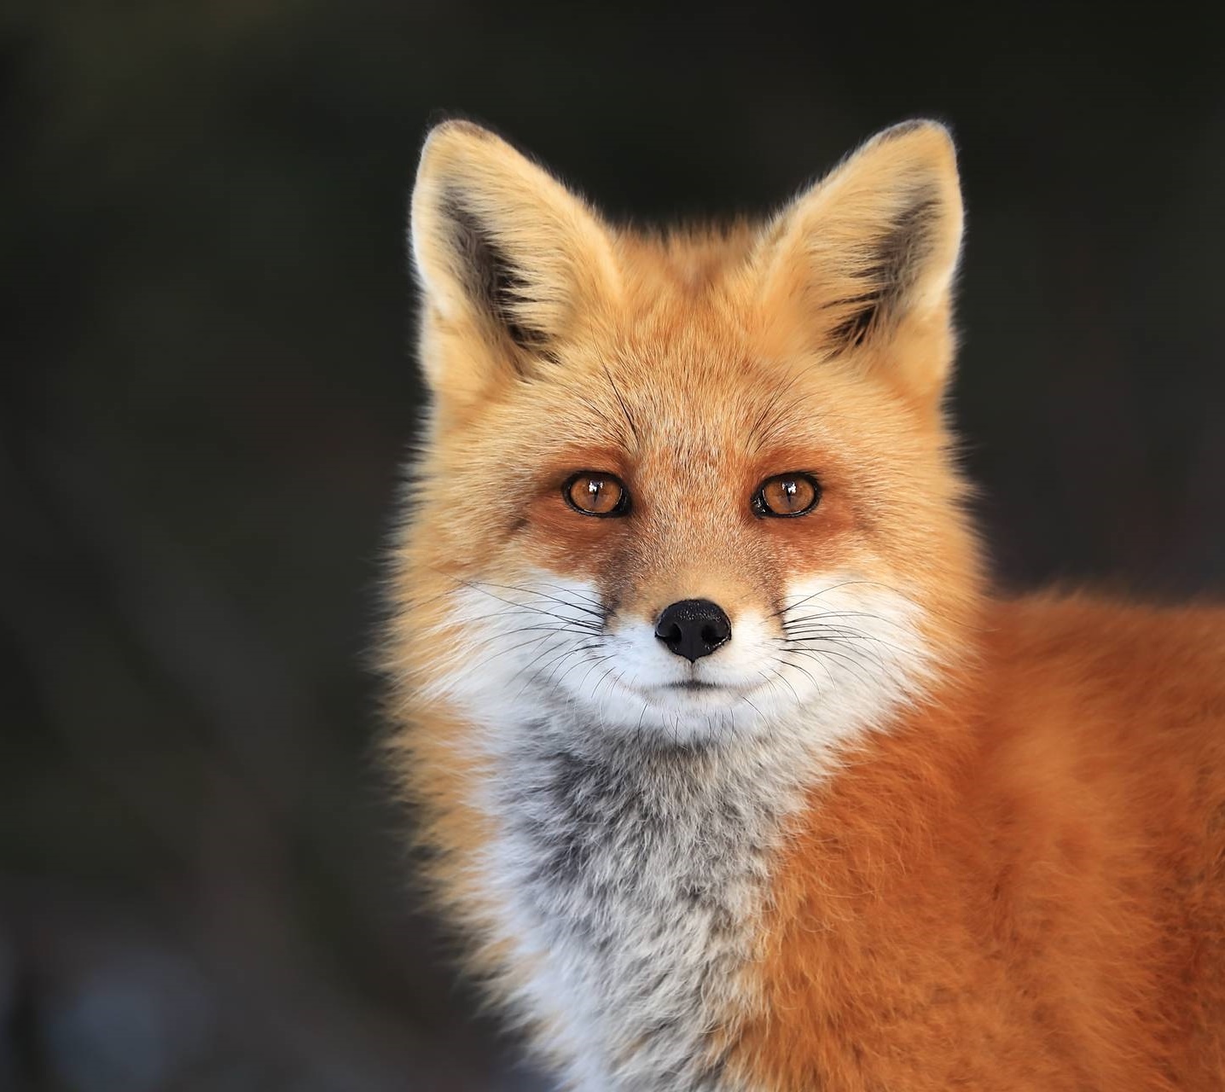
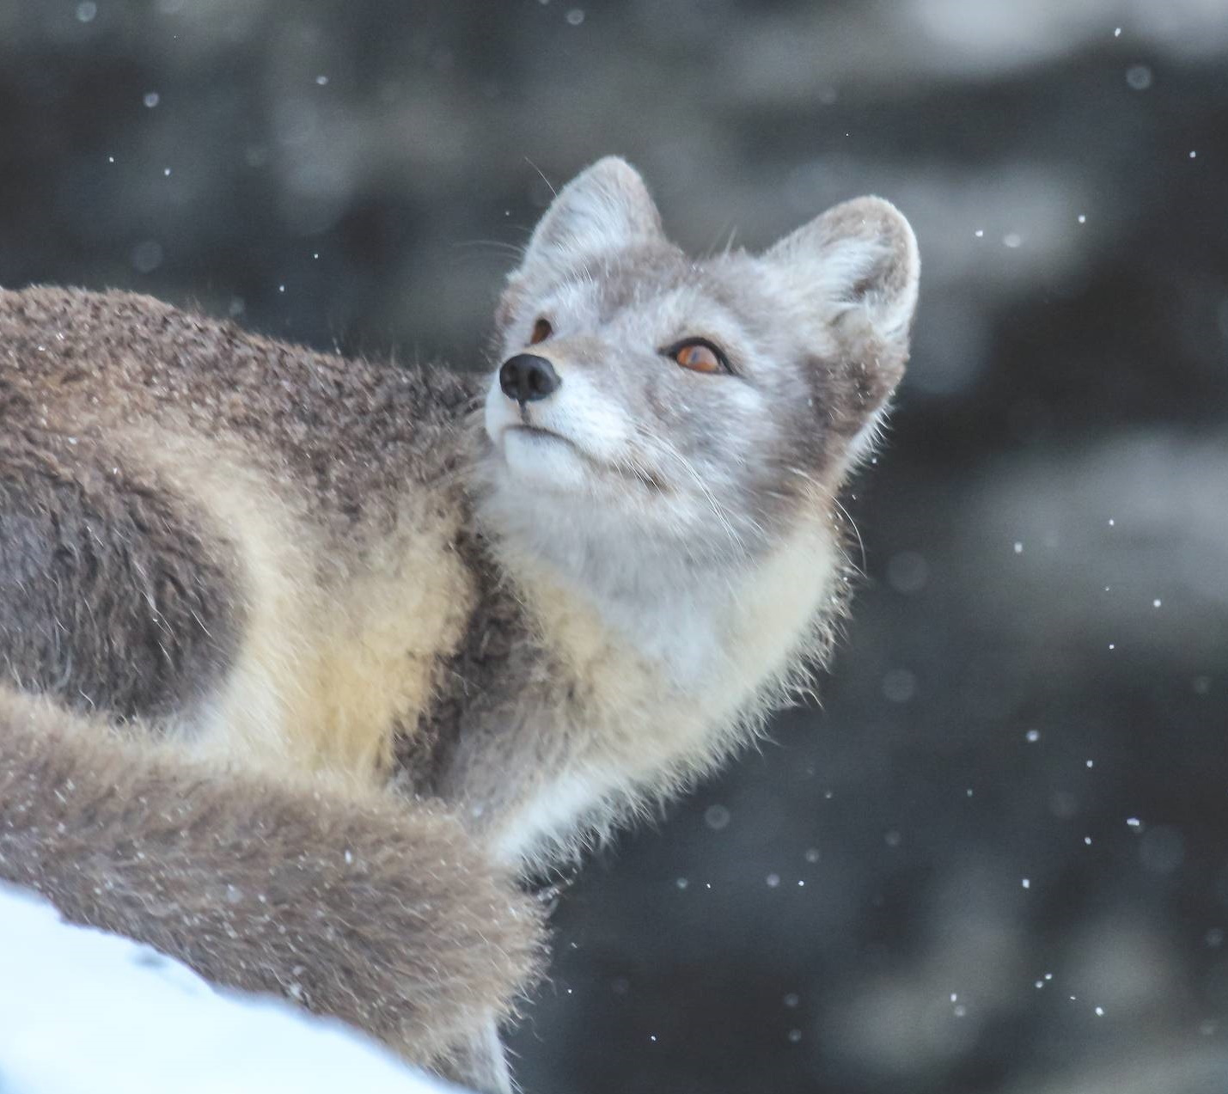
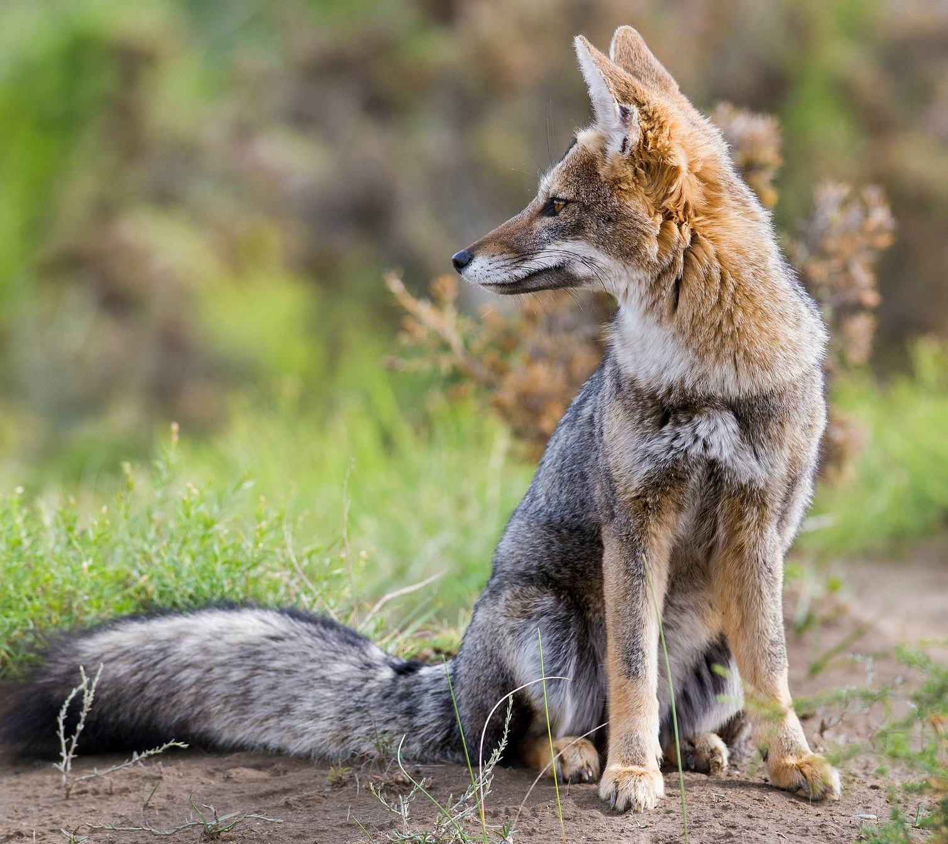
Red, cross, and silver color outcomes are controlled by two pairs of non-linked autosomal genes
Red: AABB​
Silver: AAbb​
Cross: AaBb​

Slide 19
One-sentence headline stating the main takeaway message for the slide; no longer than two lines

Slide 20
Cross and silver color variants occur less frequently in dense fox populations
Coat color distribution in different size populations
15%
Silver
10%
10%
Cross
5%
75%
Red
85%
Average sized population
(<100 foxes in territory)
Dense sized population
(<100 foxes in territory)

Slide 21
One-sentence headline stating the main takeaway message for the slide; no longer than two lines

Slide 22

Elevation plays a role: Cross and silver color variants occur more frequently at elevations over 1828 meters (6000 ft)
9% silver
18% silver
5% cross
9% cross
86% red
73% red

Slide 23
In summary… followed by a sentence which restates the most important assertion of the presentation
Supporting point 1. No longer than two lines
Supporting point 2. No longer than two lines
Questions?

Slide 24
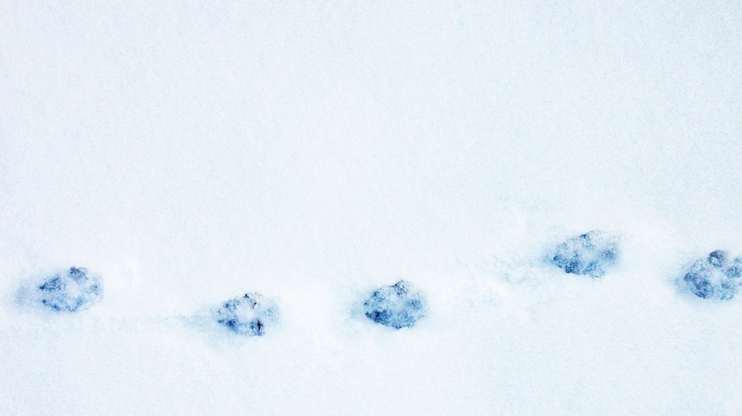
In summary, environmental factors affect coat-color variation in red foxes​
Population density impacts coat-color outcomes
Geographic elevation impacts coat-color outcomes
Questions?

Slide 25
In summary… followed by a sentence which restates the most important assertion of the presentation
Supporting point 1. no longer than two lines
Supporting point 2. no longer than two lines
Questions?

Slide 26
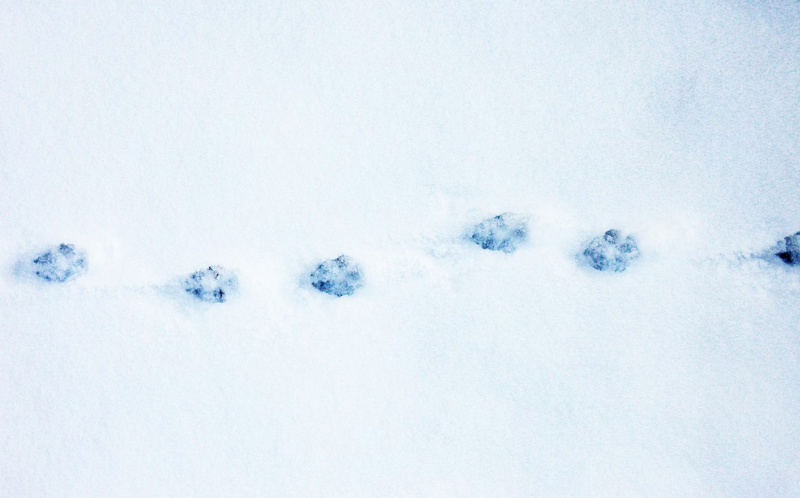
In summary, environmental factors affect coat-color variation in red foxes​
Population density impacts coat-color outcomes
Geographic elevation impacts coat-color outcomes
Questions?

Slide 27

This template was created in cooperation with scientific presentations expert Melissa Marshall. This template will help those presenting technical information be more understandable and engaging by using an “assertion/evidence” strategy. For more information, visit her website or listen to her TED talk.​ ​ Melissa’s approach is also informed by Michael Alley’s book, The Craft of Scientific Presentations.​

